Slide 1
AI is more than just ChatGPT

Slide 2

❗❗

Slide 3
Deep Learning with Artificial Neural Networks (ANN)

Slide 4
House Price Prediction Data
<--------------------------------Input—---------------------------->
Output
No. of Bedrooms | Area | YearBuilt | HousePrice
2 | 500 | 2003 | 400000
3 | 1200 | 2012 | 1200000

Slide 5
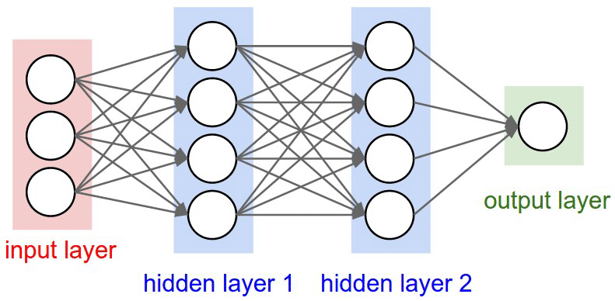
No. of Bedrooms
House Price
Area
YearBuilt

Slide 6
NLP - Sentiment Analysis Data
Textual data cannot be directly passed to Artificial Neural Networks (ANN).
Text data must be converted into numerical vectors before processing.
Techniques to convert text data include:
One-Hot Encoding
Word2Vec
Bag of Words
Word Embeddings
Input | Output
My name is Saurav | 1
I am working in Tbz | 1
My role is TL | 0

Slide 7
One-Hot Encoding
My = [ 1 0 0 0 0 0 0 0 0 0 0 ] am = [ 0 0 0 0 0 1 0 0 0 0 0 ]
Name = [ 0 1 0 0 0 0 0 0 0 0 0 ] working = [ 0 0 0 0 0 0 1 0 0 0 0 ]
is = [ 0 0 1 0 0 0 0 0 0 0 0 ] in = [ 0 0 0 0 0 0 0 1 0 0 0 ]
Saurav = [ 0 0 0 1 0 0 0 0 0 0 0 ] Tbz = [ 0 0 0 0 0 0 0 0 1 0 0 ]
I = [ 0 0 0 0 1 0 0 0 0 0 0 ] role = [ 0 0 0 0 0 0 0 0 0 1 0 ]
TL = [ 0 0 0 0 0 0 0 0 0 0 1 ]

Slide 8
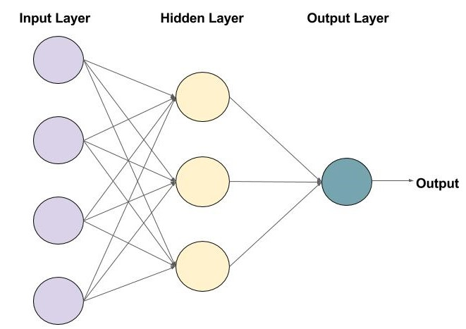
One-Hot Encoding
My
name
is
Saurav
Row 1 : My name is Saurav
My = [ 1 0 0 0 0 0 0 0 0 0 0 ]
Name = [ 0 1 0 0 0 0 0 0 0 0 0 ]
Is = [ 0 0 1 0 0 0 0 0 0 0 0 ]
Saurav = [ 0 0 0 1 0 0 0 0 0 0 0 ]

Slide 9
One-Hot Encoding
I
am
working
in
Tbz
Row 2 : I am working in Tbz
I = [ 0 0 0 0 1 0 0 0 0 0 0 ]
am = [ 0 0 0 0 0 1 0 0 0 0 0 ]
working = [ 0 0 0 0 0 0 1 0 0 0 0 ]
in = [ 0 0 0 0 0 0 0 1 0 0 0 ]
Tbz = [ 0 0 0 0 0 0 0 0 1 0 0 ]

Slide 10
Any Solutions for the Problem Occurred?

Slide 11
Zero Padding !

Slide 12
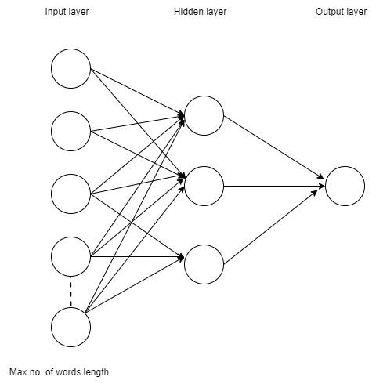
Zero Padding
My
name
is
Saurav [ 0 0 0 0 0 …]
In our case:
The maximum number of words in a sentence is : n=5
My = [ 1 0 0 0 0 0 0 0 0 0 0 ]
Name = [ 0 1 0 0 0 0 0 0 0 0 0 ]
Is = [ 0 0 1 0 0 0 0 0 0 0 0 ]
Saurav = [ 0 0 0 1 0 0 0 0 0 0 0 ]
_ = [ 0 0 0 0 0 0 0 0 0 0 0 ]
n

Slide 13
Drawbacks of ANN
Inability to Handle Sequential Data Well
Fixed Input Size
After adding Zero padding :
Increased Computational Cost
Increased Risk of Overfitting
Difficulty with Long-Term Dependencies
n

Slide 14
Recurrent Neural Network (RNN)

Slide 15
NLP - Sentiment Analysis Data
Input | Output
My name is Saurav | 1
I am working in Tbz | 1
My role is TL | 0

Slide 16
One-Hot Encoding
My = [ 1 0 0 0 0 0 0 0 0 0 0 ] am = [ 0 0 0 0 0 1 0 0 0 0 0 ]
Name = [ 0 1 0 0 0 0 0 0 0 0 0 ] working = [ 0 0 0 0 0 0 1 0 0 0 0 ]
Is = [ 0 0 1 0 0 0 0 0 0 0 0 ] in = [ 0 0 0 0 0 0 0 1 0 0 0 ]
Saurav = [ 0 0 0 1 0 0 0 0 0 0 0 ] Tbz = [ 0 0 0 0 0 0 0 0 1 0 0 ]
I = [ 0 0 0 0 1 0 0 0 0 0 0 ] role = [ 0 0 0 0 0 0 0 0 0 1 0 ]
TL = [ 0 0 0 0 0 0 0 0 0 0 1 ]

Slide 17
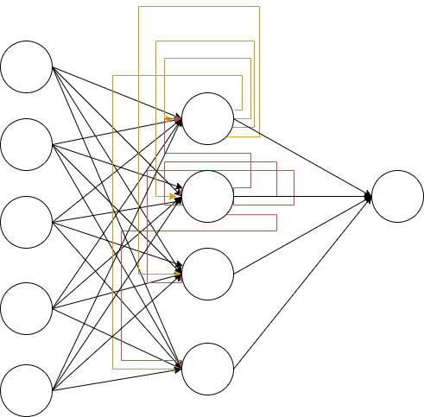
x11
X1 = My name is Saurav
x11 = My = [ 1 0 0 0 0 0 0 0 0 0 0 ]
x12 = Name = [ 0 1 0 0 0 0 0 0 0 0 0 ]
x13 = is = [ 0 0 1 0 0 0 0 0 0 0 0 ]
x14 = Saurav = [ 0 0 0 1 0 0 0 0 0 0 0 ]
1
0
0
0
.
.
0

Slide 18
x12
X1 = My name is Saurav
x11 = My = [ 1 0 0 0 0 0 0 0 0 0 0 ]
x12 = Name = [ 0 1 0 0 0 0 0 0 0 0 0 ]
x13 = is = [ 0 0 1 0 0 0 0 0 0 0 0 ]
x14 = Saurav = [ 0 0 0 1 0 0 0 0 0 0 0 ]
0
1
0
0
.
.
0

Slide 19
x13
X1 = My name is Saurav
x11 = My = [ 1 0 0 0 0 0 0 0 0 0 0 ]
x12 = Name = [ 0 1 0 0 0 0 0 0 0 0 0 ]
x13 = is = [ 0 0 1 0 0 0 0 0 0 0 0 ]
x14 = Saurav = [ 0 0 0 1 0 0 0 0 0 0 0 ]
0
0
1
0
.
.
0

Slide 20
x14
X1 = My name is Saurav
x11 = My = [ 1 0 0 0 0 0 0 0 0 0 0 ]
x12 = Name = [ 0 1 0 0 0 0 0 0 0 0 0 ]
x13 = is = [ 0 0 1 0 0 0 0 0 0 0 0 ]
x14 = Saurav = [ 0 0 0 1 0 0 0 0 0 0 0 ]
0
0
0
1
.
.
0

Slide 21
Problems with RNN

Slide 22
Long-term dependency
Sentence 1 :
Marathi is spoken in _______ .
Sentence 2 :
Gujarat, known for its rich culture and vibrant traditions, is a beautiful place that attracts travelers from all around the world with its stunning landscapes, ancient temples, and warm hospitality. I went there last year, eager to explore its historical landmarks and taste the local cuisine, but unfortunately, I couldn’t fully enjoy my trip as I struggled to communicate and navigate due to my limited understanding of ______ .

Slide 23
Long-term dependency
Short-term dependency :
Marathi is spoken in ___Maharashtra____.
Long-term dependency :
Gujarat, known for its rich culture and vibrant traditions, is a beautiful place that attracts travelers from all around the world with its stunning landscapes, ancient temples, and warm hospitality. I went there last year, eager to explore its historical landmarks and taste the local cuisine, but unfortunately, I couldn’t fully enjoy my trip as I struggled to communicate and navigate due to my limited understanding of ____Gujarati____.

Slide 24

Vanishing and exploding gradient descent
Predicted value
y^ = ⨏ ( w*x + b) where ⨏ = activation function (sigmoid, tanh, relu, etc…)
Cost function
L( y , y^) = - y * log(y^) - (1 - y) * log(1 - y^)
where y = actual, y^ = predicted
Back Propagation
where 𝛂 = learning rate

Slide 25



Vanishing and exploding gradient descent
w₁₁
o₂₁
o₃
0.025 0.10
o₂₂

Slide 26
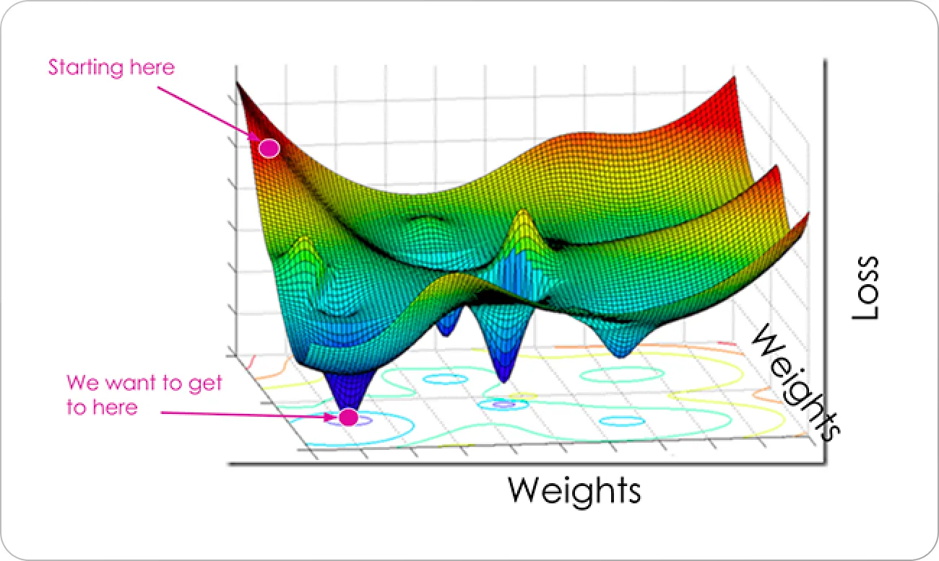
Vanishing and exploding gradient descent

Slide 27
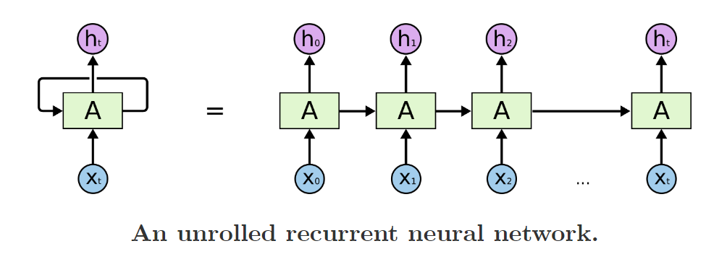
RNN Unrolled Architecture

Slide 28
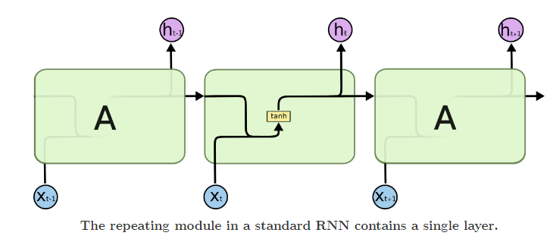
RNN Architecture

Slide 29
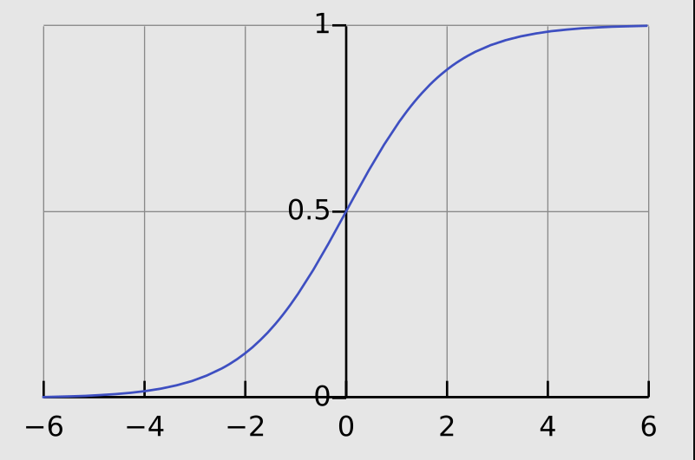
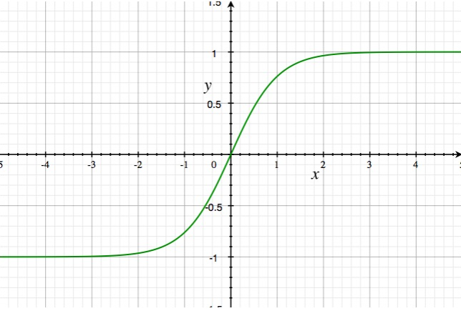


Activation Functions Graph
Sigmoid
Tanh

Slide 30
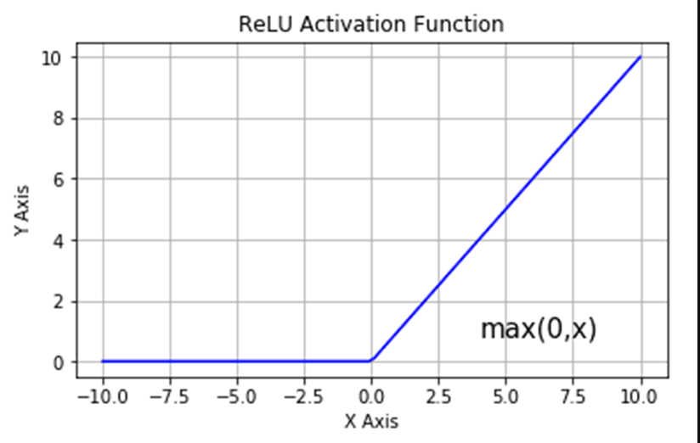
Activation Functions Graph

Slide 31
Long Short Term Memory (LSTM)
Blog article : LSTM

Slide 32
Example 1:
Saurav eats samosa almost everyday, it shouldn't be hard to guess that his favorite cuisine is ___________.

Slide 33
Example 1:
Saurav eats samosa almost everyday, it shouldn't be hard to guess that his favorite cuisine is ___Indian___.

Slide 34
Example 1: Chatgpt response
Saurav eats samosa almost everyday, it shouldn't be hard to guess that his favorite cuisine is Indian.
Indian
“” “” samosa samosa samosa
Saurav eats samosa almost

Slide 35
Example 2:
Saurav eats samosa almost everyday, it shouldn't be hard to guess that his favorite cuisine is Indian. My brother Krunal however is a lover of pasta and cheese that means his favourite cuisine is _____________.

Slide 36
Example 2: Chatgpt response
Saurav eats samosa almost everyday, it shouldn't be hard to guess that his favorite cuisine is Indian. My brother Krunal however is a lover of pasta and cheese that means his favourite cuisine is ___Italian____.

Slide 37
Saurav eats samosa almost everyday, it shouldn't be hard to guess that his favorite cuisine is Indian. My brother Krunal however is a lover of pasta and cheese that means his favourite cuisine is Italian.
“” “” samosa samosa samosa
Saurav eats samosa almost Indian
Italian
samosa pasta pasta pasta,cheese pasta,cheese
My pasta and cheese

Slide 38
RNN Architecture

Slide 39
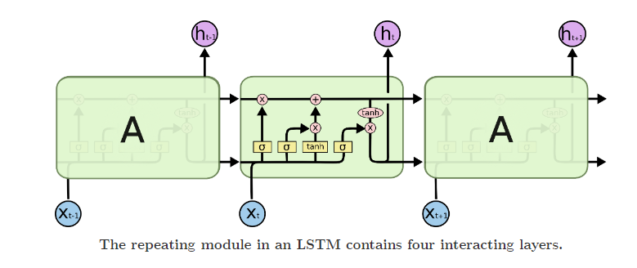
LSTM Architecture

Slide 40
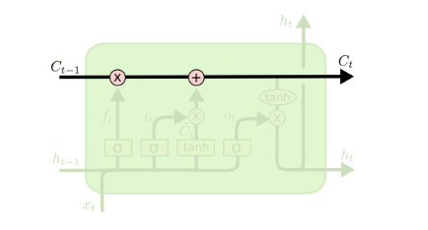
LSTM Architecture
The cell state
Memory Storage
Conveyor belt analogy : moving information forward with little interference, only updating when necessary.

Slide 41
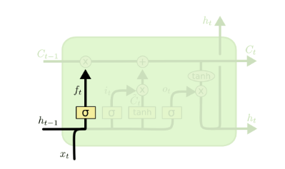

Forget gate
what information we’re going to throw away from the cell state.
This decision is made by a sigmoid layer.
outputs a number between 0 and 1
Sigmoid output :
𝛔 =
1 represents completely keep this
0 represents completely get rid of this

Slide 42
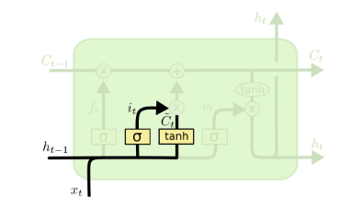
Input gate
what new information we’re going to store in the cell state.
A tanh layer creates a vector of new candidate values, C_{t}~ that could be added to the state

Slide 43
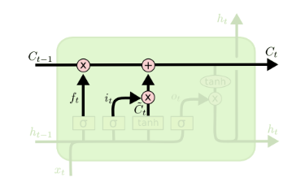
Update gate
It’s time to update the old state (C_{t-1} ) into the new cell state C_{t}
We multiply the old state by f_{t} forgetting the things we decided to forget earlier.
Then we add i_{t}∗C_{t}~
This is the new candidate values, scaled by how much we decided to update each state value.

Slide 44
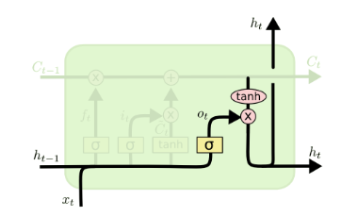
Output gate
Finally, we need to decide what we’re going to output
This output will be based on our cell state, but will be a filtered version
First, we run a sigmoid layer which decides what parts of the cell state we’re going to output
Then, we put the cell state through tanh and multiply it by the output of the sigmoid gate, so that we only output the parts we decided to

Slide 45
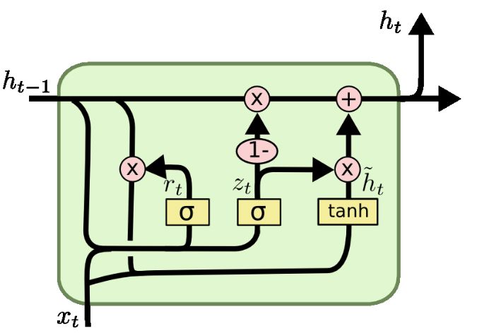
GRU ( Gated Recurrent Unit )

Slide 46
Sequence to Sequence Model

Slide 47
Encoder-Decoder
Architecture

Slide 48
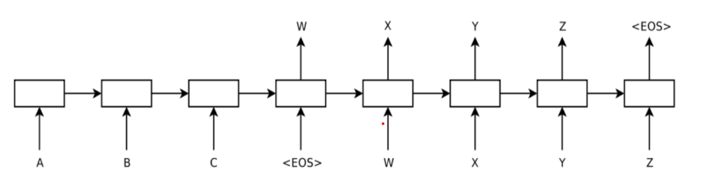
Encoder-Decoder Architecture
<—--------------------- Encoder —--------------------------> ←—-------------------- Decoder —------------------------->
Context vector
Ilya Sutskever, Oriol Vinyals, and Quoc V. Le. Sequence to Sequence Learning with Neural Networks. 2014. https://arxiv.org/pdf/1409.3215

Slide 49
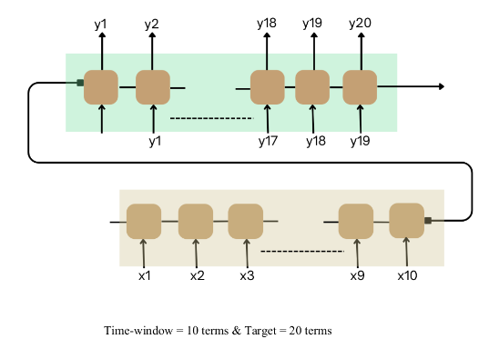
Time-series forecasting

Slide 50
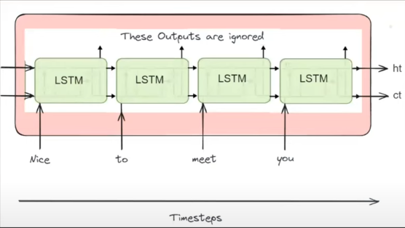
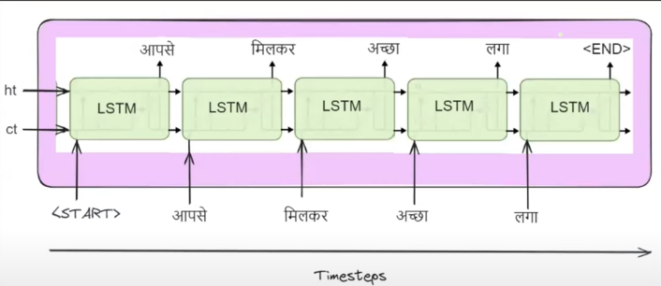
Machine Translation
^{Context vector}
Decoder
Encoder

Slide 51
Attention Model

Slide 52
Aarav stepped forward and the world changed.

Slide 53
In a quiet village nestled between rolling hills, a curious boy named Aarav spent his days exploring the lush forests surrounding his home. One afternoon, while wandering deeper than ever before, he stumbled upon a hidden clearing bathed in golden light. At its center stood an ancient oak tree, its trunk carved with strange symbols. As Aarav approached, the symbols began to glow, and the air filled with a soft hum. He reached out to touch the tree, and in an instant, the world around him shifted—revealing a hidden realm filled with creatures and wonders beyond his imagination.

Slide 54
